Slide 1
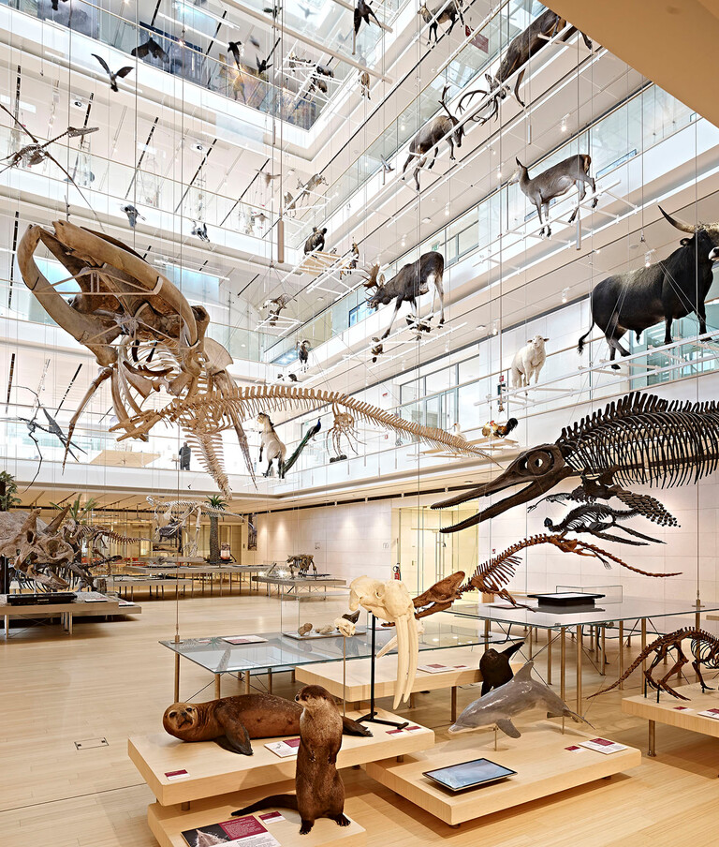
STAY POINT DETECTION IN A MUSEUM
2021 - 2022
Geospatial Data Management
final project

Slide 2
TABLE OF CONTENTS
02
01
PROBLEM TO SOLVE
02
DATASET
03
IMPLEMENTATION & RESULTS
04
EXPERIMENTS
05
IDENTIFICATION OF VISITED EXHIBITS

Slide 3
PROBLEM TO SOLVE
Stay point: geographical region in which the user stayed for a certain period of time
Point where the user stopped for a certain amount of time
Point that is the centroid of a set of points where the user stayed for a certain amount of time
Stay Point Detection algorithm: identifies spatial regions in which the user stayed for a certain amount of time
Benefits:
add semantic to trajectory data
increase our knowledge on user behaviour

Slide 4
PROBLEM IN OUR PROJECT
Trajectories of visitors of a museum
Results:
Exhibits that created more interest
Benefits:
Better organize the exhibits
Increase the engagement
Improve the experience

Slide 5
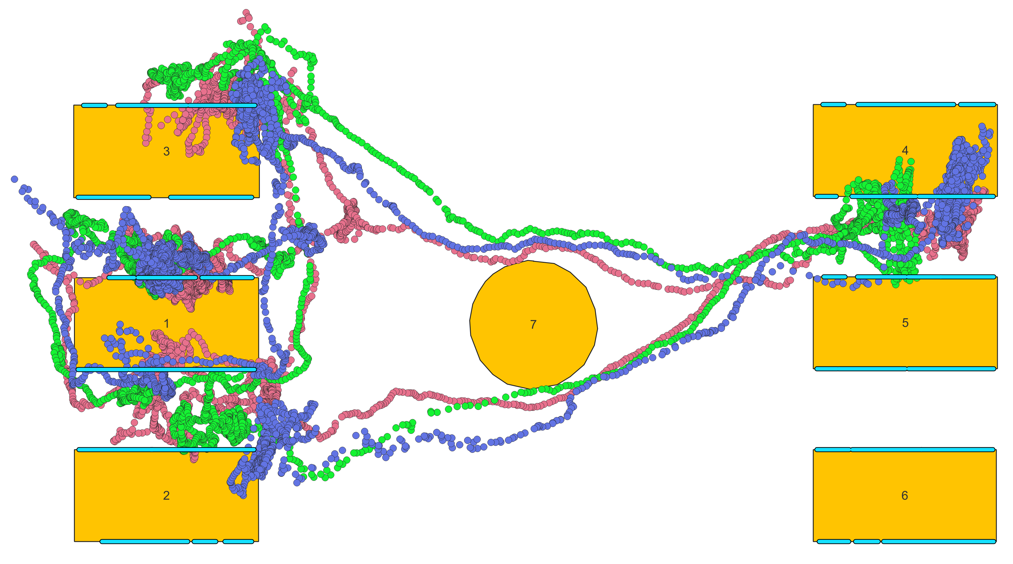
DATASET
Trajectories of 3 visitors
Position and timestamp between 12:08 and 12:20 of 13/12/2021
7388 points for visitor with id 57
7008 points for visitor with id 6
7211 points for visitor with id 68
Very high sampling rate
Localization system on UWB
Tables in the museum
Id and position
7 tables
Exhibits on tables:
Id and position
35 exhibits

Slide 6
IMPLEMENTATION & RESULTS
PRE-PROCESSING
ALGORITHM
RESULTS
FURTHER EXPERIMENTS
SQL
Python
PostGIS
QGIS
SQL
Python
PostGIS
Python
PostGIS
QGIS
SQL
Python
PostGIS
QGIS

Slide 7
PRE-PROCESSING
VISITOR 57
19.8%
VISITOR 67
19.5%
35.5%
VISITOR 68

Slide 8
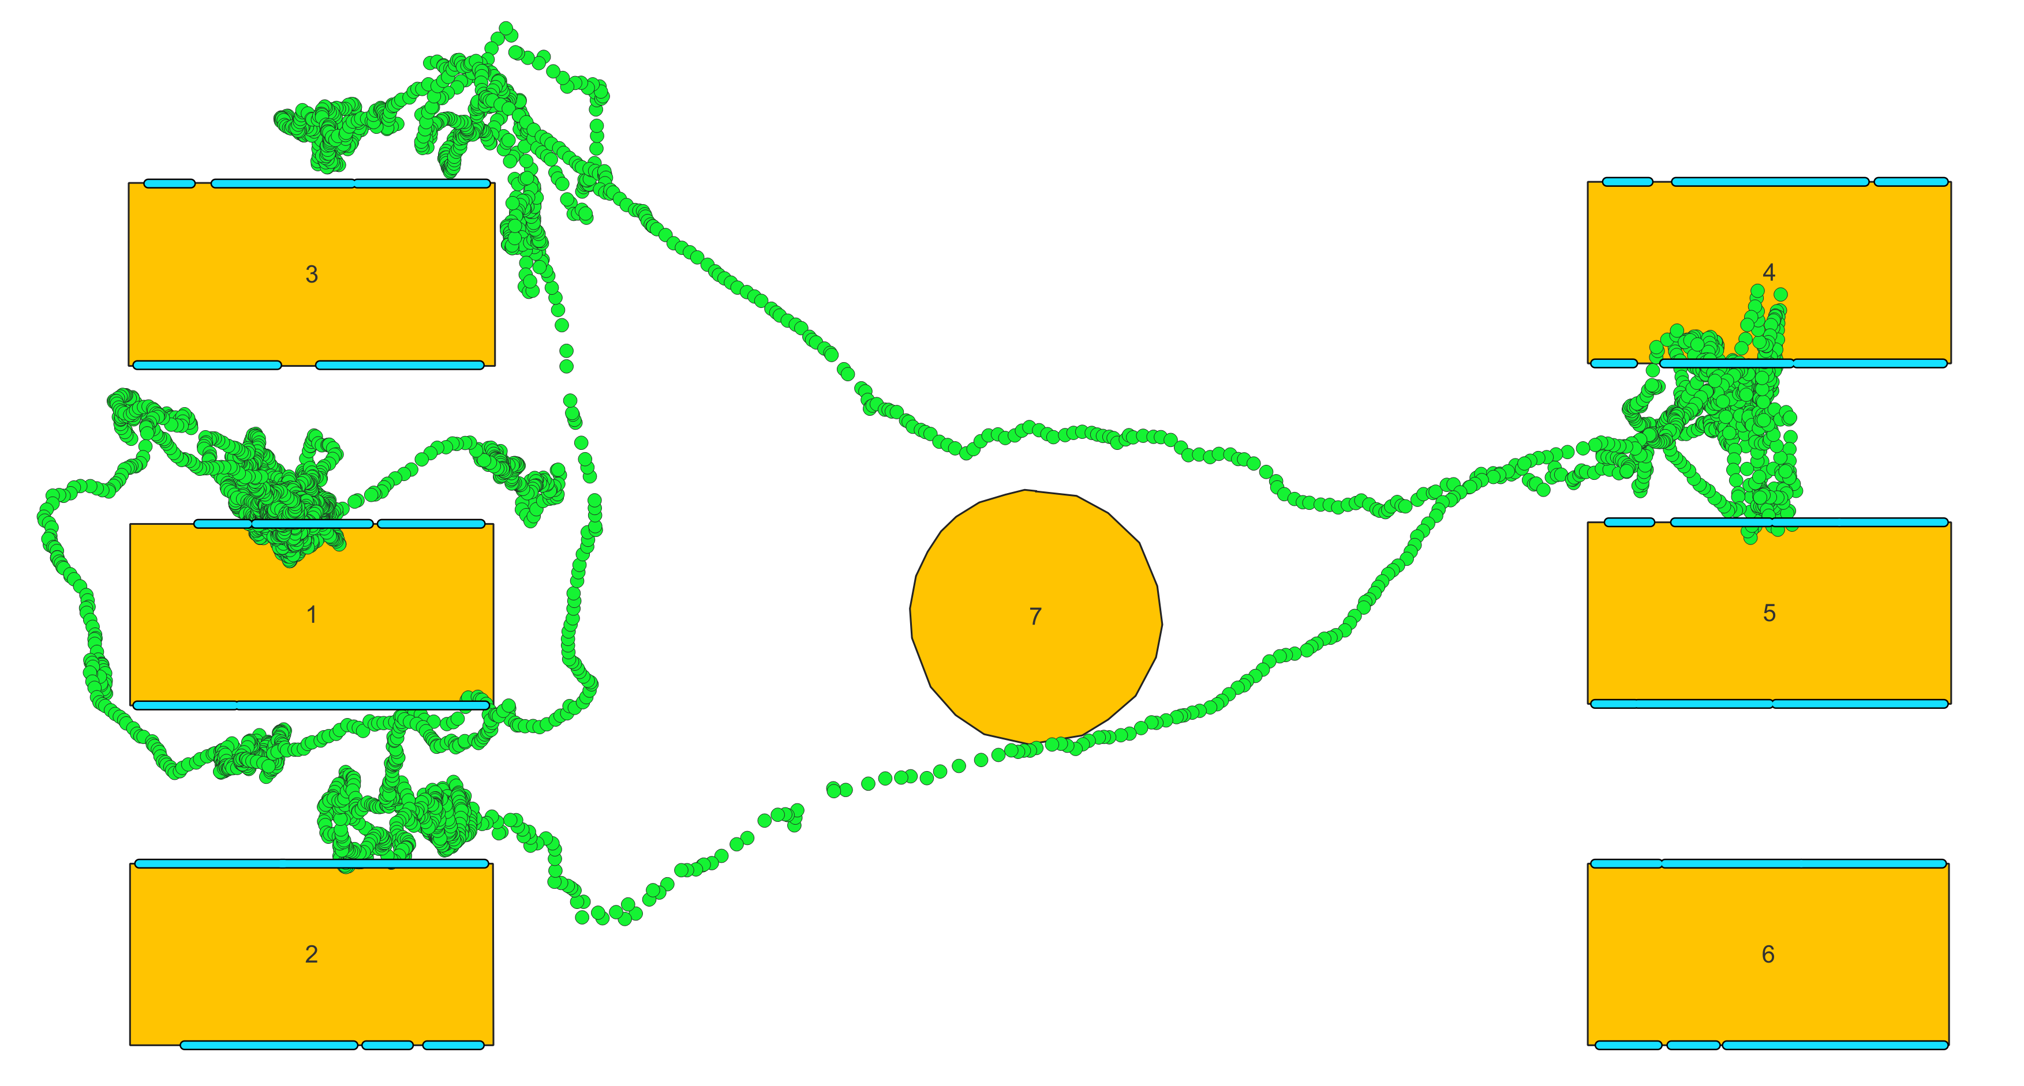
PRE-PROCESSING
Some points are on the tables
Localization system has a limited error: probably the user is close to the table but outside of it
Points with errors points on the closest border of the table

Slide 9
PRE-PROCESSING - SQL
CREATE TABLE IF NOT EXISTS person_57_refined as
(SELECT * FROM person_57)
CREATE TABLE IF NOT EXISTS intersection_tables_57 as
(SELECT DISTINCT p1.id, p1.geom as geom
FROM person_57 as p1
WHERE p1.geom in
(SELECT DISTINCT st_intersection(p1.geom, t.geom) as geom FROM person_57 as p1, tables as t))
CREATE TABLE IF NOT EXISTS closest_points_57 as
(SELECT DISTINCT p.id,
st_closestpoint(st_boundary(t.geom), p.geom) as geom
FROM intersection_tables_57 as p, tables as t
WHERE st_intersects(p.geom, t.geom))

Slide 10
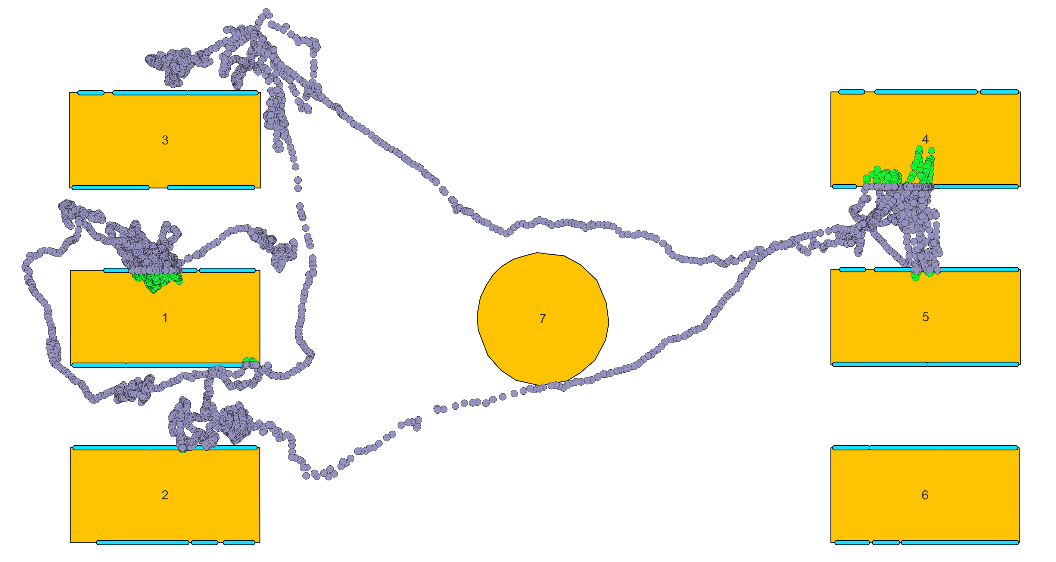
PRE-PROCESSING - SQL
UPDATE person_57_refined
SET geom = c.geom
FROM closest_points_57 as c
WHERE c.id = person_57_refined.id

Slide 11
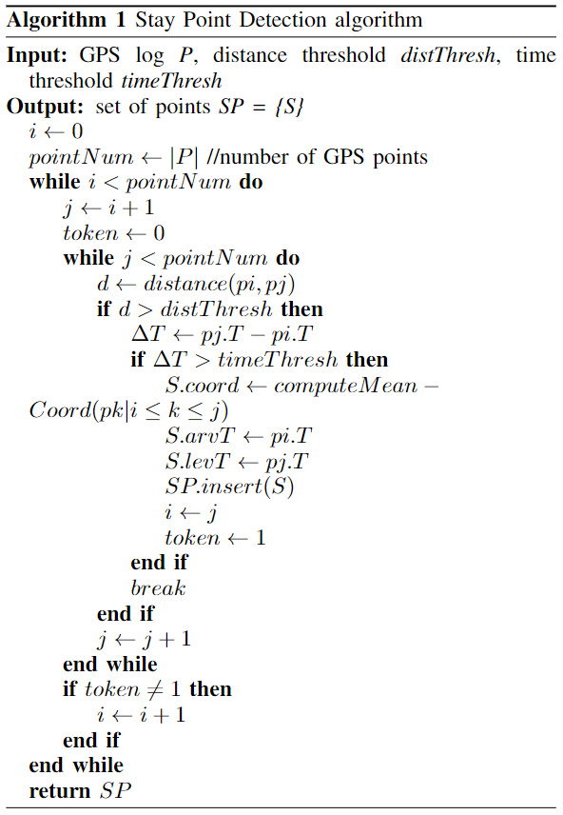
ALGORITHM
timeThresh = 30 s
Trajectories data on only 10 minutes
Bigger time threshold: leave out possible stay points
Smaller time threshold: not meaningful, given the movement by foot
distThresh = 1 m
Museum space: table distance
More exhibits on each table
Bigger distance threshold: trouble understanding what exhibits are visited, confusion between exhibits of close tables

Slide 12
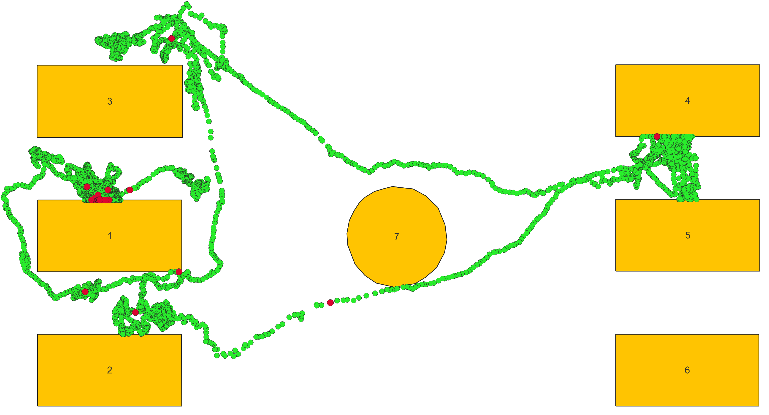
RESULTS
Visitor 57
11 stay points

Slide 13
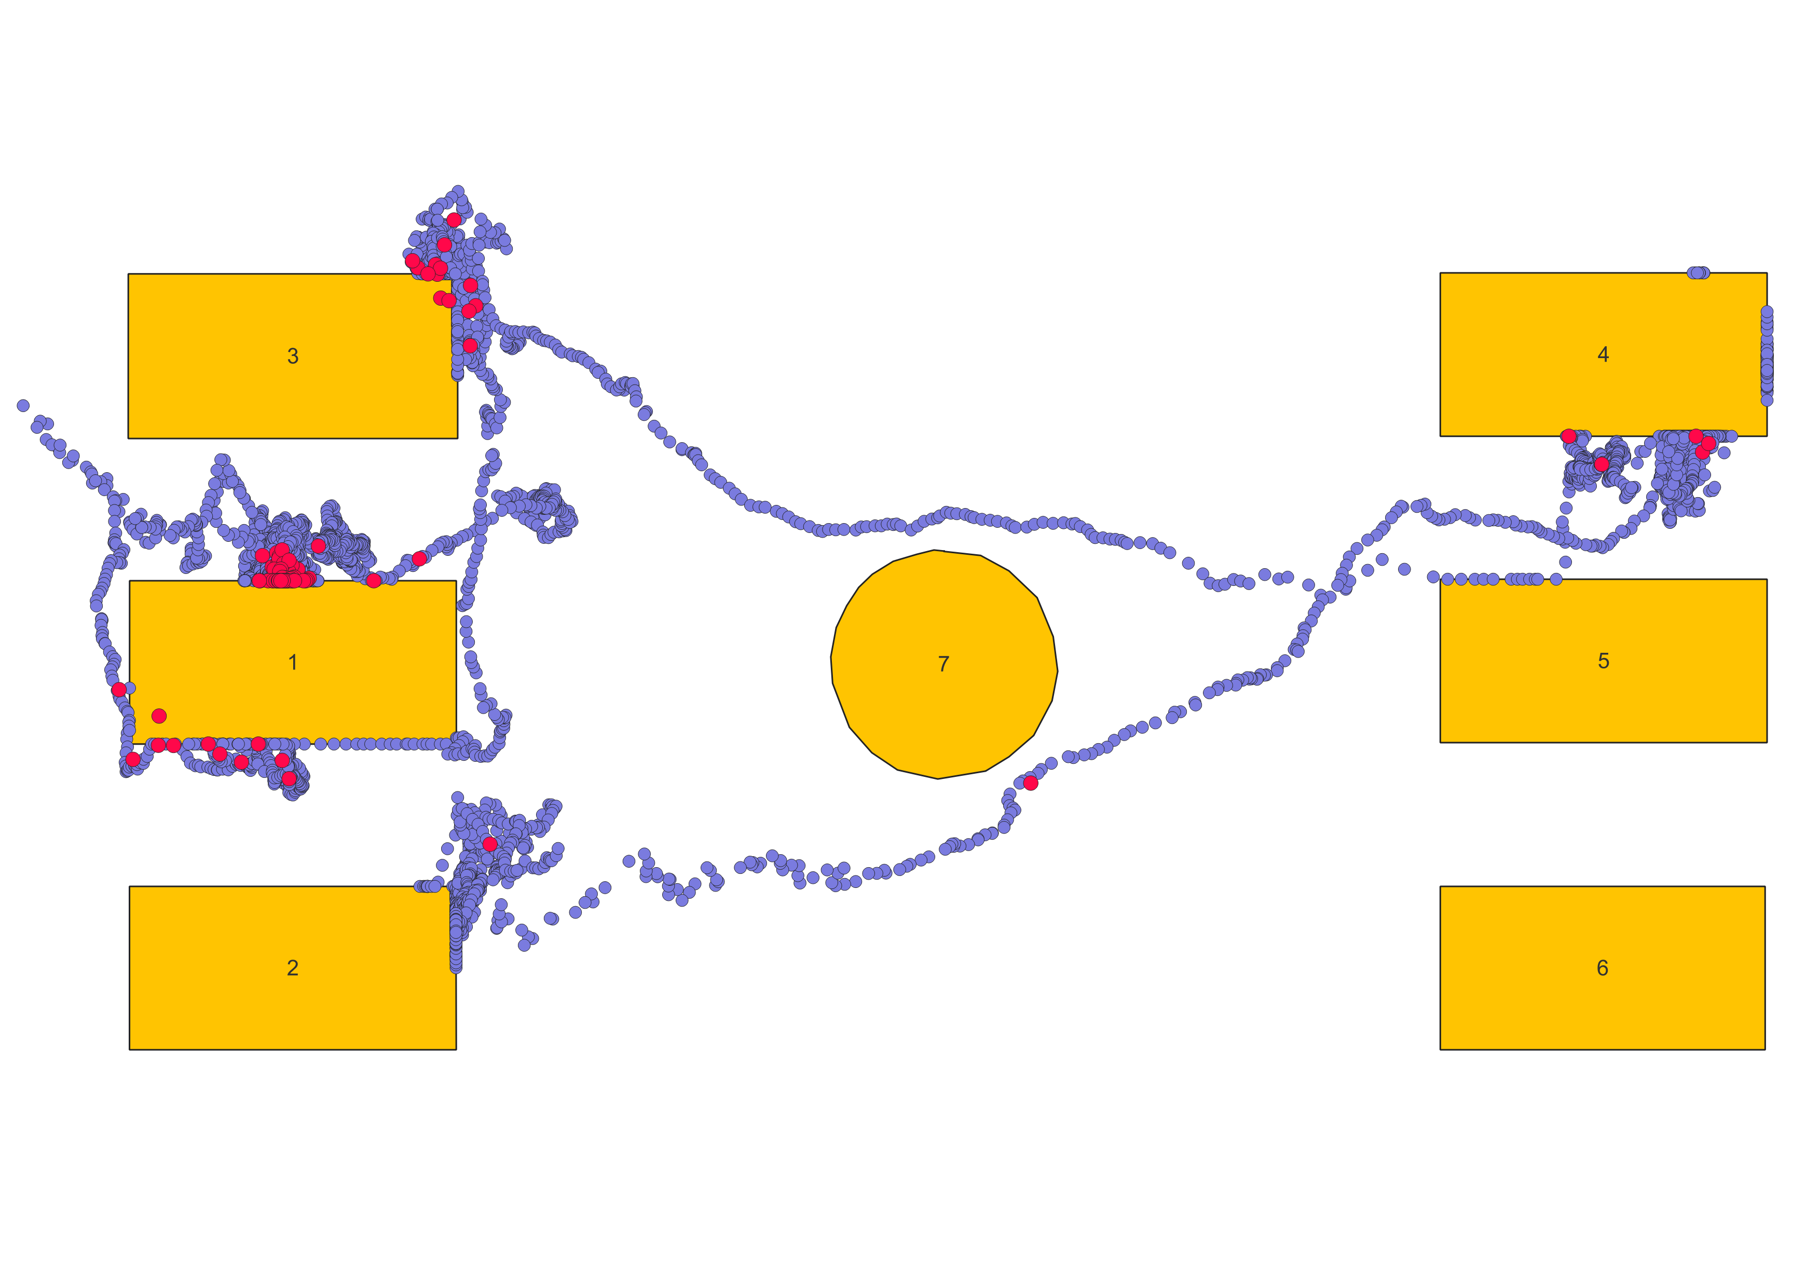
RESULTS
Visitor 67
13 stay points

Slide 14
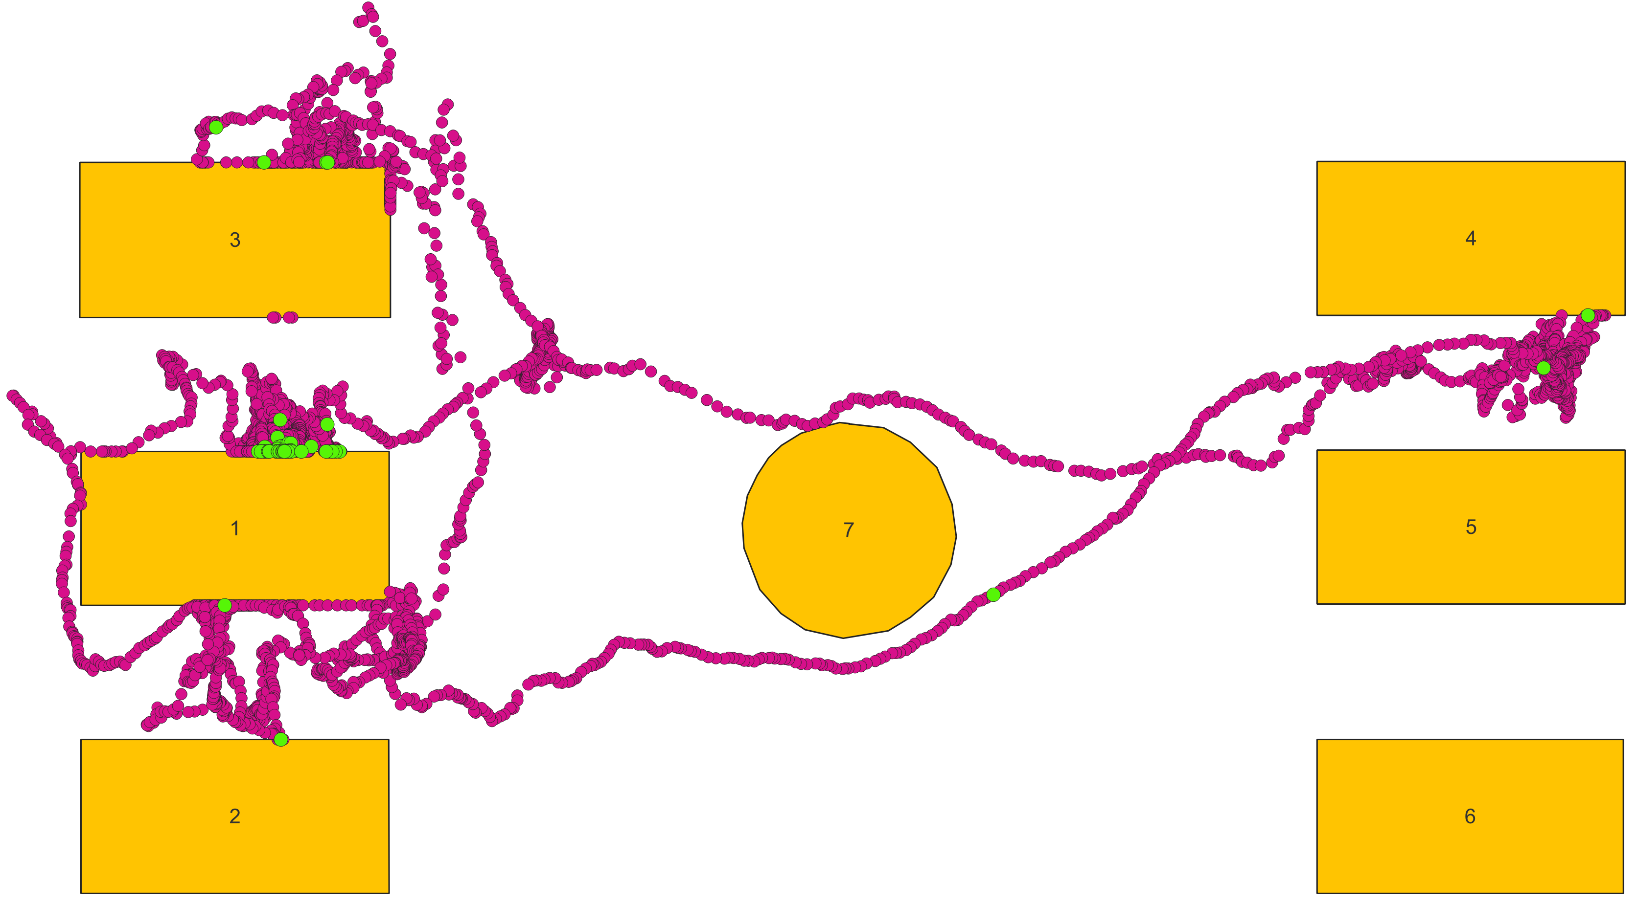
RESULTS
Visitor 68
12 stay points

Slide 15
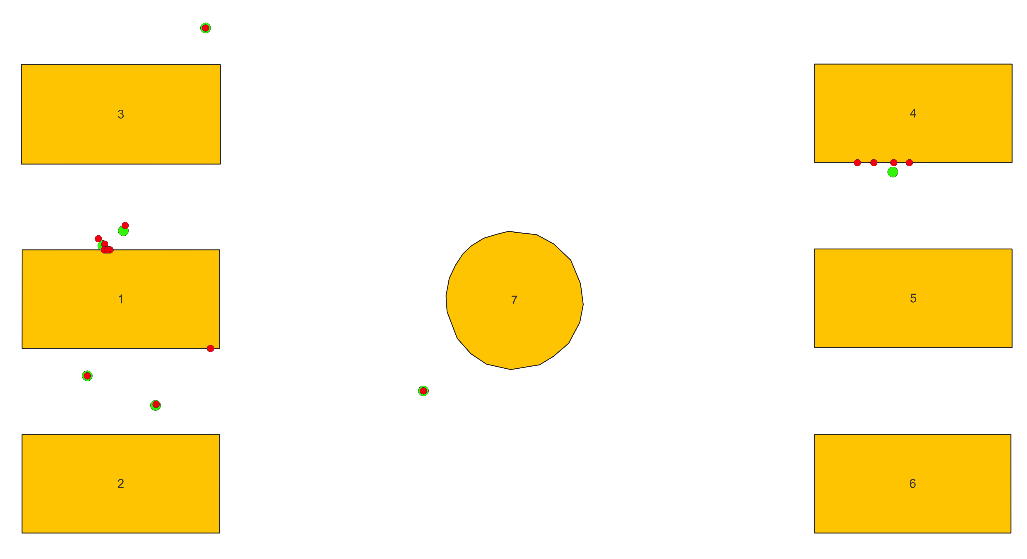
FURTHER EXPERIMENTS
Visitor 57
Algorithm execution without pre-processing (points in red)
Algorithm execution with pre-processing (points in green)
7 stay points in red

Slide 16
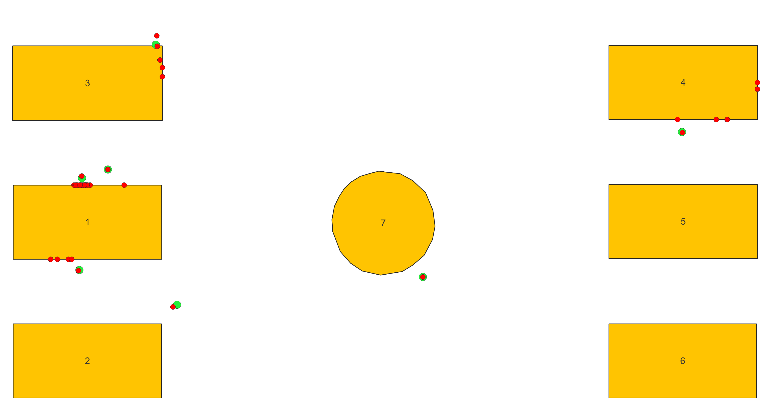
FURTHER EXPERIMENTS
Visitor 67
Algorithm execution without pre-processing (points in red)
Algorithm execution with pre-processing (points in green)
7 stay points in red

Slide 17
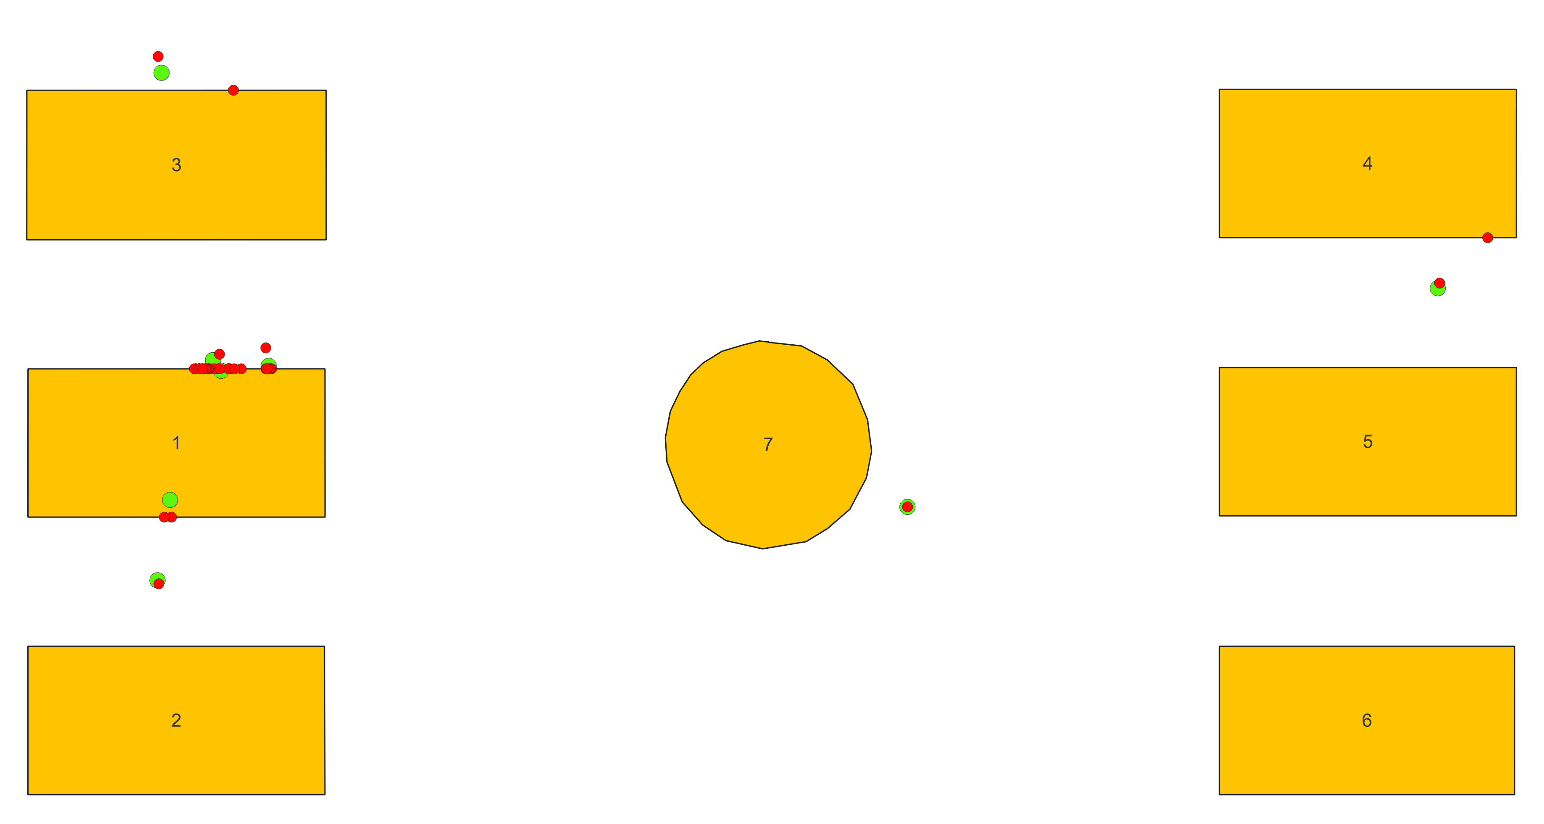
FURTHER EXPERIMENTS
Visitor 68
Algorithm execution without pre-processing (points in red)
Algorithm execution with pre-processing (points in green)
12 stay points in red

Slide 18
FURTHER EXPERIMENTS
Some points overlap
Other points are very similar
Pre-processing has not corrupted original data and has kept their information
Gives more credibility to the results

Slide 19
IDENTIFICATION OF VISITED EXHIBITS
Exhibits that captured visitors’ interest: less than 1 m distance between stay points and closest exhibits
SELECT p.id, p.geom AS p, p.arrivtime, p.leavetime, e.geom AS geom
FROM exhibits_on_tables AS e, (
SELECT p.geom, MIN(ST_DISTANCE(p.geom, e.geom)) AS minDist FROM stay_points_57 as p, exhibits_on_tables as e
GROUP BY p.geom) AS i
JOIN stay_points_57 AS p
ON p.geom = i.geom
WHERE ST_DISTANCE(p.geom, e.geom) = i.minDist
AND ST_DISTANCE(p.geom, e.geom) < 1)

Slide 20
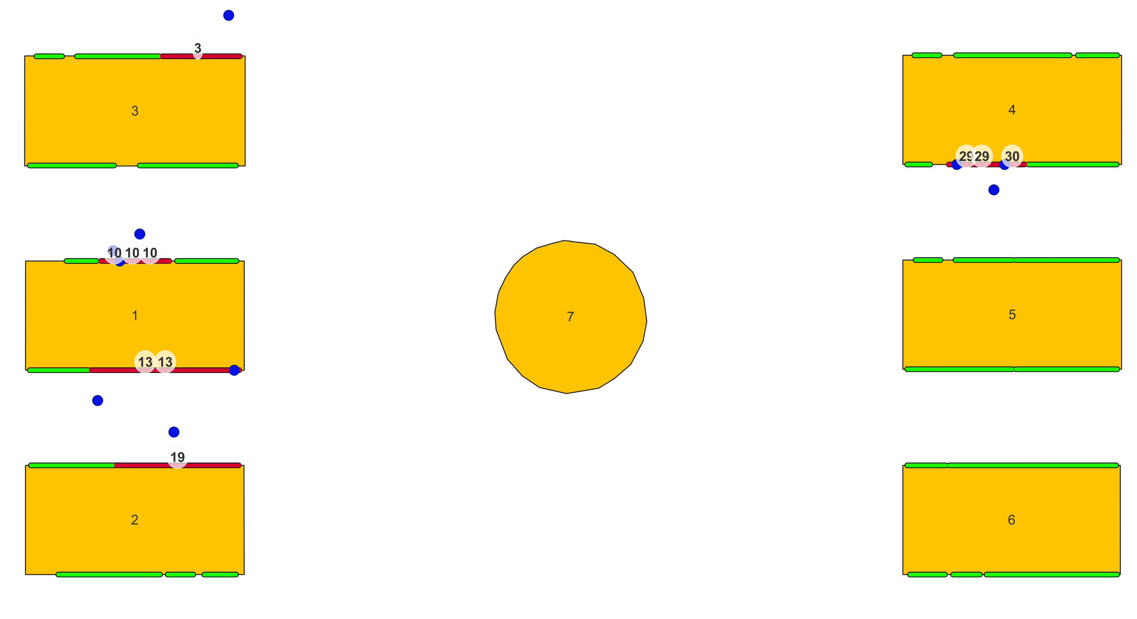
IDENTIFICATION OF VISITED EXHIBITS
Visitor 57
Exhibits 3, 10, 13, 19, 29, 30

Slide 21
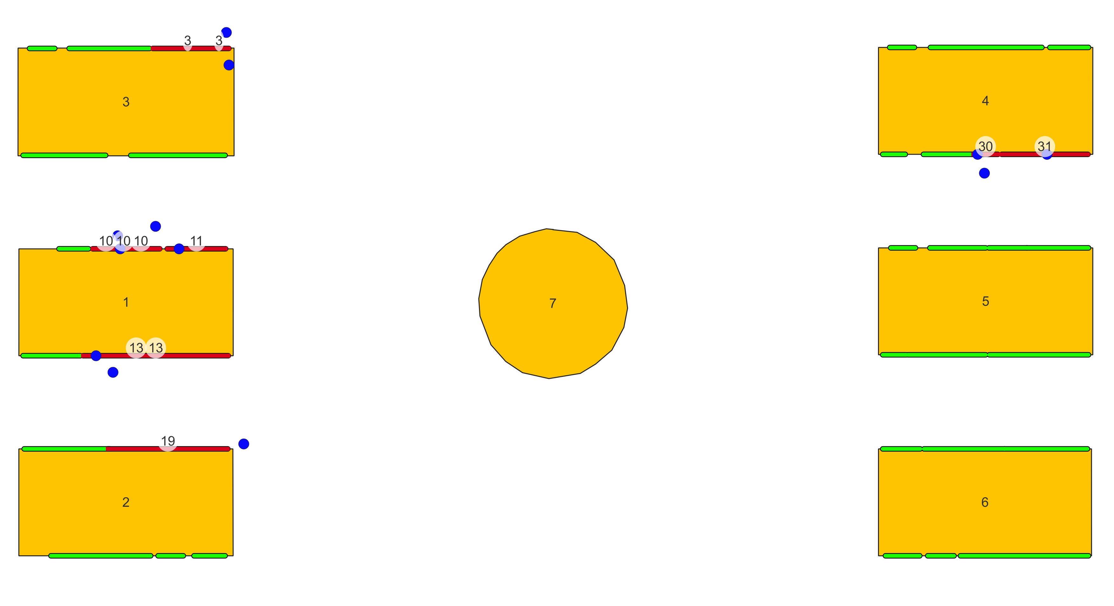
IDENTIFICATION OF VISITED EXHIBITS
Visitor 67
Exhibits 3, 10, 11, 13, 19, 30, 31

Slide 22
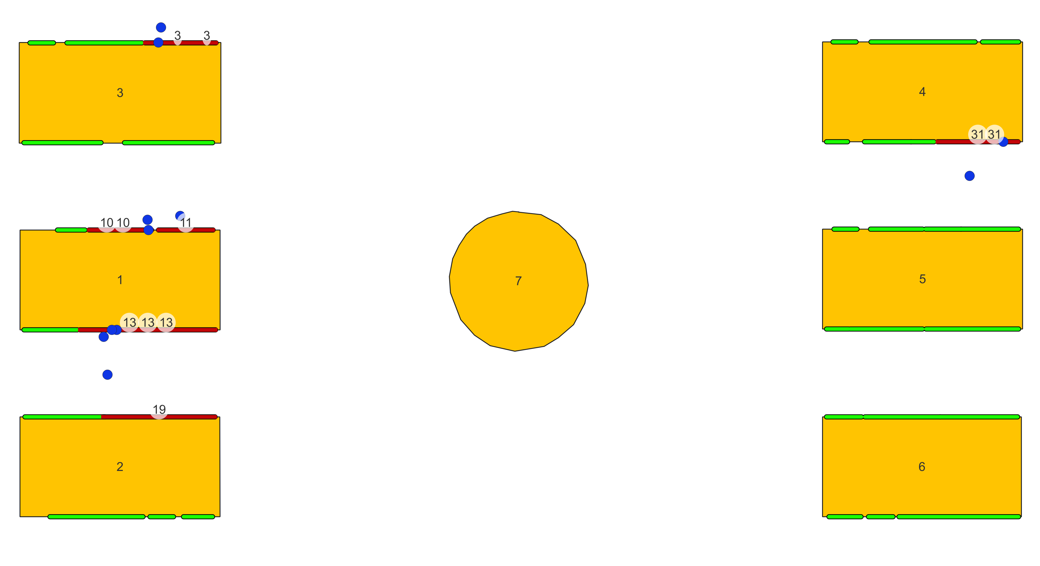
IDENTIFICATION OF VISITED EXHIBITS
Visitor 68
Exhibits 3, 10, 11, 13, 19, 31

Slide 23
SUMMARY
 | EXHIBITS
VISITOR 57 | 3, 10, 13, 19, 29, 30
VISITOR 67 | 3, 10, 11, 13, 19, 30, 31
VISITOR 68 | 3, 10, 11, 13, 19, 31

Slide 24
IDENTIFICATION OF VISITED EXHIBITS
More than one stay point of a visitor relate to the same exhibit
For each exhibit, centroid of the stay points that relate to the same exhibit
Time interval = oldest arrival time – latest leave time
SELECT DISTINCT p.exhibitid, c.centroid as geom, c.arrivalTime, c.leaveTime
FROM (SELECT exhibitid, st_centroid(st_collect(point)) as centroid,
min(arrivtime) as arrivalTime, max(leavetime) as leaveTime
FROM exhibits_person_57
GROUP BY exhibitid) as c
JOIN exhibits_person_57 AS p
ON p.exhibitid = c.exhibitid)

Slide 25
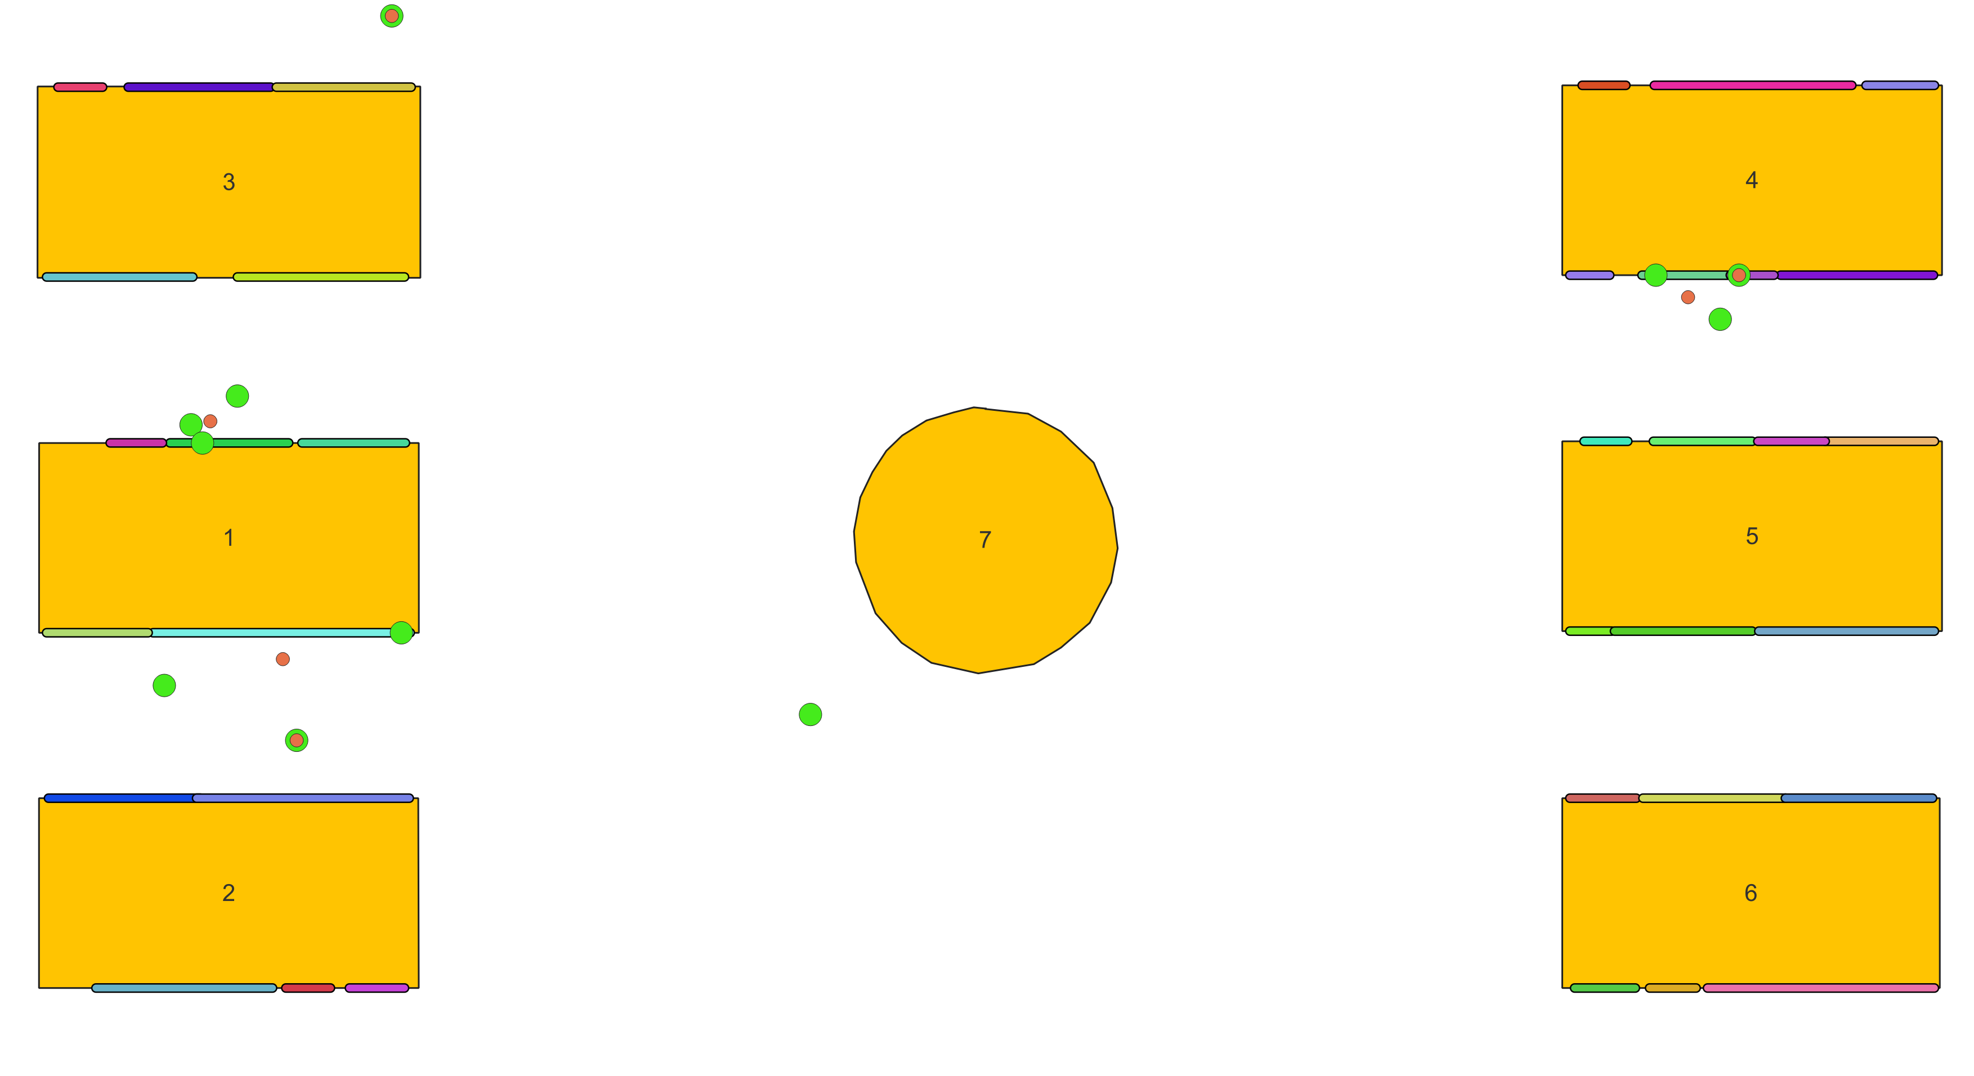
IDENTIFICATION OF VISITED EXHIBITS
Visitor 57

Slide 26
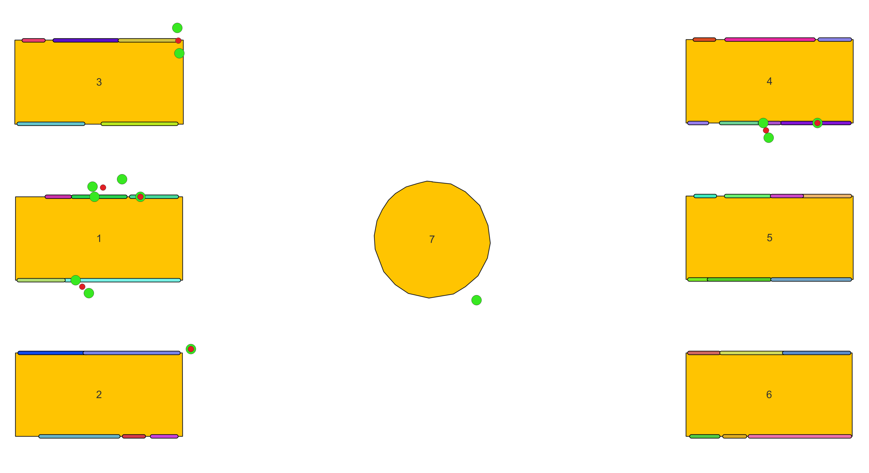
IDENTIFICATION OF VISITED EXHIBITS
Visitor 67

Slide 27
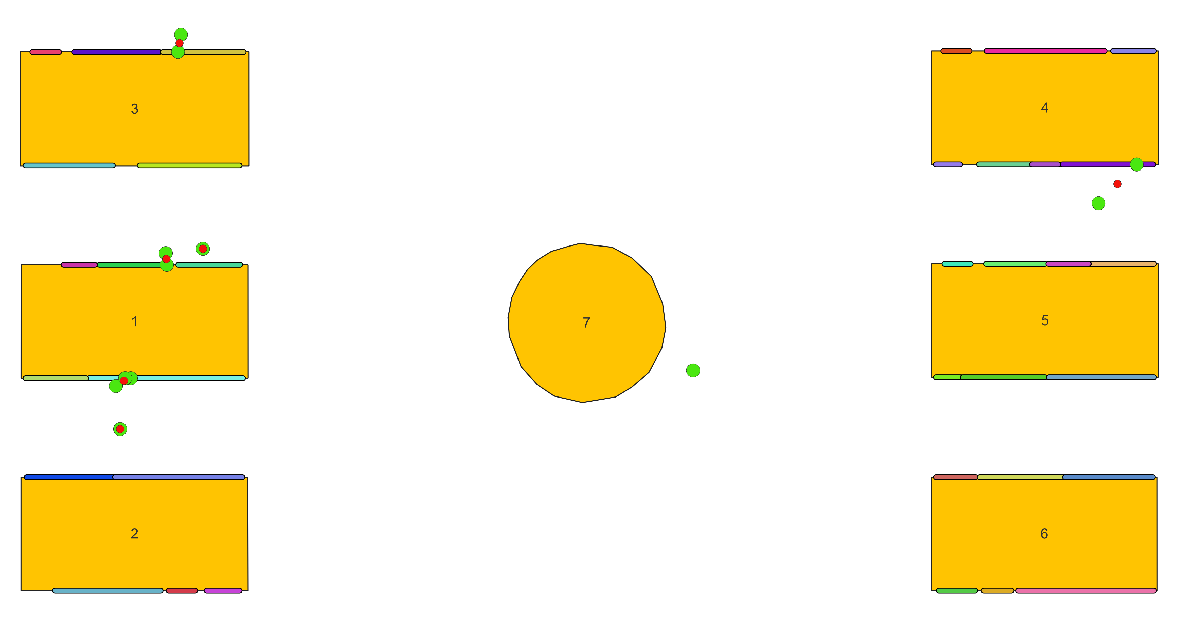
IDENTIFICATION OF VISITED EXHIBITS
Visitor 68

Slide 28
IDENTIFICATION OF VISITED EXHIBITS
Exhibits visited by more visitors at the same time
Overlap in intervals of stay points or centroids of stay points close to the same exhibits
SELECT p1.exhibitid, p2.exhibited
FROM centroids_exhibits_person_57 as p1, centroids_exhibits_person_67 as p2
WHERE (p2.leaveTime, p2.arrivalTime) OVERLAPS (p1.leaveTime, p1.arrivalTime)
AND p1.exhibitid = p2.exhibitid

Slide 29
SUMMARY
 | VISITORS | NUMBER OF VISITORS
EXHIBIT 3 | 57, 67, 68 | 3
EXHIBIT 10 | 57, 67, 68 | 3
EXHIBIT 11 | 67, 68 | 2
EXHIBIT 13 | 57, 67, 68 | 3
 | VISITORS | NUMBER OF VISITORS
EXHIBIT 19 | 57, 67, 68 | 3
EXHIBIT 29 | 57 | 1
EXHIBIT 30 | 57, 67 | 2
EXHIBIT 31 | 67, 68 | 2

Slide 30
CONCLUSION
Results:
Stay points of three visitors of a museum
Visited exhibits
Exhibits visited by more than one visitor at the same time
The most visited exhibits
Goal:
Study behavior of visitors
Better design the museal space
Improve the experience
Improvements:
Rumor reduction
Stay point detection algorithm
Identification of visited exhibits

Slide 31
THANKS!
Jaspreet Kaur - 980691
Marco Incerti - 989428

